Slide 1



x
<University Of Isfahan> <Operating Systems project>
Samba Server By
Amina Shojaei
Parnian Alasvandian
Here your text

Slide 2

x
<University Of Isfahan> <Operating Systems project>
Table Of Contents
{01} Project Goals
{02} What is Samba?
{03} How to install and use Samba?
2/9

Slide 3

x
<University Of Isfahan> <Operating Systems project>
{01}
Project Goals
Install and config Samba Server
Access the other operating system
through any of the operating systems
3/9

Slide 4
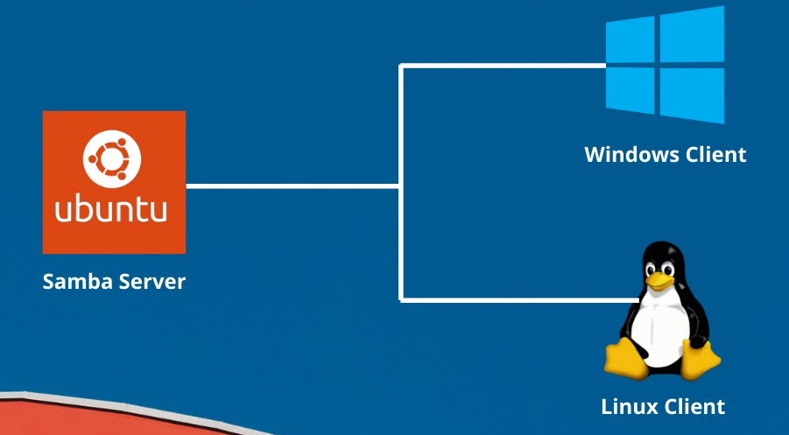
x
<University Of Isfahan> <Operating Systems project>
{02}What is Samba?
Why was Samba Created?
What does Samba do?
Samba says:
“Samba is the standard Windows
interoperability suite of programs
for Linux and Unix.”
4/9

Slide 5

x
<University Of Isfahan> <Operating Systems project>
{03}How to install and use Samba?
Step 01 Download and setup Samba
sudo apt update
sudo apt install samba
sudo nano /etc/samba/smb.conf
5/9

Slide 6

x
<University Of Isfahan> <Operating Systems project>
Step 02 Specify the folder you want to share
[sambashare]
Path = /home/parnian/sambashare
Read only = no
Guest ok = yes
6/9

Slide 7

x
<University Of Isfahan> <Operating Systems project>
Step 03 Make directory and set permissions
sudo mkdir -p /home/parnian/sambashare
sudo chmod 777 /home/parnian/sambashare
sudo systemctl restart smbd
7/9

Slide 8
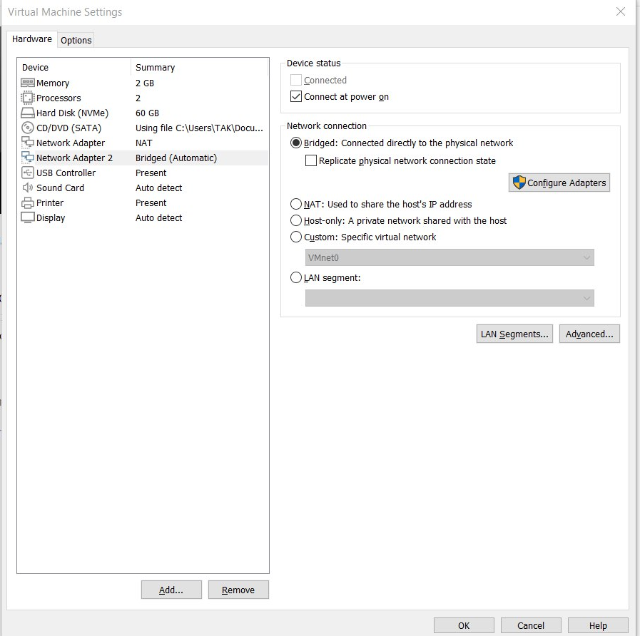
x
<University Of Isfahan> <Operating Systems project>
{!}Warning!
Add another Network Adapter
Set it on bridge mode
8/9

Slide 9



x
<University Of Isfahan> <Operating Systems project>
Thanks for your attention
Now Let's put our knowledge to the test
}
}
}
}
}
}
9/9

